Slide 1


The PiXL Club The PiXL Club The PiXL Club The PiXL Club The PiXL Club The PiXL Club The PiXL Club The PiXL Club The PiXL Club The PiXL Club The PiXL Club The PiXL Club The PiXL Club The PiXL Club The PiXL Club The PiXL Club The PiXL Club The PiXL Club The PiXL Club The PiXL Club The PiXL Club The PiXL Club The PiXL Club The PiXL Club The PiXL Club The PiXL Club The PiXL Club The PiXL Club The PiXL Club The PiXL Club The PiXL Club The PiXL Club The PiXL Club The PiXL Club The PiXL Club The PiXL Club The PiXL Club The PiXL Club The PiXL Club The PiXL Club The PiXL Club The PiXL Club The PiXL Club The PiXL Club The PiXL Club XL Club The PiXL Club The PiXL Club The PiXL Club The PiXL Club The PiXL Club The PiXL Club The PiXL Club The PiXL Club The PiXL Club The PiXL Club The PiXL Club The PiXL Club The PiXL Club The PiXL Club The PiXL Club The PiXL Club The PiXL Club The PiXL Club The PiXL Club The PiXL Club The PiXL Club The PiXL Club The PiXL Club The PiXL Club The PiXL Club The PiXL Club The PiXL Club The PiXL Club The PiXL Club The PiXL Club The PiXL Club The PiXL Club The PiXL Club The PiXL Club The PiXL Club The PiXL Club The PiXL Club The PiXL Club The PiXL Club The PiXL Club The PiXL Club The PiXL Club The PiXL Club The PiXL Club The PiXL Club The PiXL Club The PiXL Club The PiXL Club The PiXL Club The PiXL Club The PiXL Club The PiXL Club The PiXL Club The PiXL Club The PiXL Club The PiXL Club The PiXL Club The PiXL Club The PiXL Club The PiXL Club The PiXL Club The PiXL Club The PiXL Club The PiXL Club The PiXL Club The PiXL Club The PiXL Club The PiXL Club The PiXL Club The PiXL Club The PiXL Club The PiXL Club The PiXL Club The PiXL Club The PiXL Club The PiXL Club The PiXL Club The PiXL Club The PiXL Club The PiXL Club The PiXL Club The PiXL Club The PiXL Club The PiXL Club The PiXL Club The PiXL Club The PiXL Club The PiXL Club The PiXL Club The PiXL Club The PiXL Club The PiXL Club The PiXL Club The PiXL Club The PiXL Club The PiXL Club The PiXL Club The PiXL Club The PiXL Club The PiXL Club The PiXL Club The PiXL Club The PiXL Club The PiXL Club The PiXL Club The PiXL Club The PiXL Club The PiXL Club The PiXL Club The PiXL Club The PiXL Club The PiXL Club The PiXL Club The PiXL Club The PiXL Club The PiXL Club The PiXL Club The PiXL Club The PiXL Club The PiXL Club The PiXL Club The PiXL Club The PiXL Club The PiXL Club The PiXL Club The PiXL Club The PiXL Club The PiXL Club The PiXL Club The PiXL Club The PiXL Club The PiXL Club The PiXL Club The PiXL Club The PiXL Club The PiXL Club The PiXL Club The PiXL Club The PiXL Club The PiXL Club The PiXL Club The PiXL Club The PiXL Club The PiXL Club The PiXL Club The PiXL Club The PiXL Club The PiXL Club The PiXL Club The PiXL Club The PiXL Club The PiXL Club The PiXL Club The PiXL Club The PiXL Club The PiXL Club The PiXL Club The PiXL Club The PiXL Club The PiXL Club The PiXL Club The PiXL Club The PiXL Club The PiXL Club The PiXL Club The PiXL Club The PiXL Club The PiXL Club The PiXL Club The PiXL Club The PiXL Club The PiXL Club The PiXL Club The PiXL Club The PiXL Club The PiXL Club The PiXL Club The PiXL Club The PiXL Club The PiXL Club The PiXL Club The PiXL Club The PiXL Club The PiXL Club The PiXL Club The PiXL Club The PiXL Club The PiXL Club The PiXL Club The PiXL Club The PiXL Club The PiXL Club The PiXL Club The PiXL Club The PiXL Club The PiXL Club The PiXL Club The PiXL Club The PiXL Club The PiXL Club The PiXL Club The PiXL Club The PiXL Club The PiXL Club The PiXL Club The PiXL Club The PiXL Club The PiXL Club The PiXL Club The PiXL Club The PiXL Club The PiXL Club The PiXL Club The PiXL Club The PiXL Club The PiXL Club The PiXL Club The PiXL Club The PiXL Club The PiXL Club The PiXL Club The PiXL Club The PiXL Club The PiXL Club The PiXL Club The PiXL Club The PiXL Club The PiXL Club The PiXL Club The PiXL Club The PiXL Club The PiXL Club The PiXL Club The PiXL Club The PiXL Club The PiXL Club The PiXL Club The PiXL Club The PiXL Club The PiXL Club The PiXL Club The PiXL Club The PiXL Club The PiXL Club The PiXL Club The PiXL Club The PiXL Club The PiXL Club The PiXL Club The PiXL Club The PiXL Club The PiXL Club The PiXL Club The PiXL Club The PiXL Club The PiXL Club The PiXL Club The PiXL Club The PiXL Club The PiXL Club The PiXL Club The PiXL Club The PiXL Club The PiXL Club The PiXL Club The PiXL Club The PiXL Club The PiXL Club The PiXL Club The PiXL Club The PiXL Club The PiXL Club The PiXL Club The PiXL Club The PiXL Club The PiXL Club The PiXL Club The PiXL Club The PiXL Club The PiXL Club The PiXL Club The PiXL Club The PiXL Club The PiXL Club The PiXL Club The PiXL Club The PiXL Club The PiXL Club The PiXL Club The PiXL Club The PiXL Club The PiXL Club The PiXL Club The PiXL Club The PiXL Club The PiXL Club The PiXL Club The PiXL Club The PiXL Club The PiXL Club The PiXL Club The PiXL Club The PiXL Club The PiXL Club The PiXL Club The PiXL Club The PiXL Club The PiXL Club The PiXL Club The PiXL Club The PiXL Club The PiXL Club The PiXL Club The PiXL Club The PiXL Club The PiXL Club The PiXL Club The PiXL Club The PiXL Club The PiXL Club The PiXL Club The PiXL Club The PiXL Club The PiXL Club The PiXL Club The PiXL Club The PiXL Club The PiXL Club The PiXL Club The PiXL Club The PiXL Club The PiXL Club The PiXL Club The PiXL Club The PiXL Club The PiXL Club The PiXL Club The PiXL Club The PiXL Club The PiXL Club The PiXL Club The PiXL Club The PiXL Club The PiXL Club The PiXL Club The PiXL Club The PiXL Club The PiXL Club The PiXL Club The PiXL Club The PiXL Club The PiXL Club The PiXL Club The PiXL Club The PiXL Club The PiXL Club The PiXL Club The PiXL Club The PiXL Club The PiXL Club The PiXL Club The PiXL Club The PiXL Club The PiXL Club The PiXL Club The PiXL Club The PiXL Club The PiXL Club The PiXL Club The PiXL Club The PiXL Club The PiXL Club The PiXL Club The PiXL Club The PiXL Club The PiXL Club The PiXL Club The PiXL Club The PiXL Club The PiXL Club The PiXL Club The PiXL Club The PiXL Club The PiXL Club The PiXL Club The PiXL Club The PiXL Club The PiXL Club The PiXL Club The PiXL Club The PiXL Club The PiXL Club The PiXL Club The PiXL Club The PiXL Club The PiXL Club The PiXL Club The PiXL Club The PiXL Club The PiXL Club The PiXL Club The PiXL Club The PiXL Club The PiXL Club The PiXL Club The PiXL Club The PiXL Club The PiXL Club The PiXL Club The PiXL Club The PiXL Club The PiXL Club The PiXL Club The PiXL Club The PiXL Club The PiXL Club The PiXL Club The PiXL Club The PiXL Club The PiXL Club The PiXL Club The PiXL Club The PiXL Club The PiXL Club The PiXL Club The PiXL Club The PiXL Club The PiXL Club The PiXL Club The PiXL Club The PiXL Club The PiXL Club The PiXL Club The PiXL Club The PiXL Club The PiXL Club The PiXL Club The PiXL Club The PiXL Club The PiXL Club The PiXL Club The PiXL Club The PiXL Club The PiXL Club The PiXL Club The PiXL Club The PiXL Club The PiXL Club The PiXL Club The PiXL Club The PiXL Club The PiXL Club The PiXL Club The PiXL Club The PiXL Club The PiXL Club The PiXL Club The PiXL Club The PiXL Club The PiXL Club The PiXL Club The PiXL Club The PiXL Club The PiXL Club The PiXL Club The PiXL Club The PiXL Club The PiXL Club The PiXL Club The PiXL Club The PiXL Club The PiXL Club The PiXL Club The PiXL Club The PiXL Club The PiXL Club The PiXL Club The PiXL Club The PiXL Club The PiXL Club The PiXL Club The PiXL Club The PiXL Club The PiXL Club The PiXL Club The PiXL Club The PiXL Club The PiXL Club The PiXL Club The PiXL Club The PiXL Club The PiXL Club The PiXL Club The PiXL Club The PiXL Club The PiXL Club The PiXL Club The PiXL Club The PiXL Club The PiXL Club The PiXL Club The PiXL Club The PiXL Club The PiXL Club The PiXL Club The PiXL Club The PiXL Club The PiXL Club The PiXL Club The PiXL Club The PiXL Club The PiXL Club The PiXL Club The PiXL Club The PiXL Club The PiXL Club The PiXL Club The PiXL Club The PiXL Club The PiXL Club The PiXL Club The PiXL Club The PiXL Club The PiXL Club The PiXL Club The PiXL Club The PiXL Club The PiXL Club The PiXL Club The PiXL Club The PiXL Club The PiXL Club The PiXL Club The PiXL Club The PiXL Club The PiXL Club The PiXL Club The PiXL Club The PiXL Club The PiXL Club The PiXL Club The PiXL Club The PiXL Club The PiXL Club The PiXL Club The PiXL Club The PiXL Club The PiXL Club The PiXL Club The PiXL Club The PiXL Club The PiXL Club The PiXL Club The PiXL Club The PiXL Club The PiXL Club The PiXL Club The PiXL Club The PiXL Club The PiXL Club The PiXL Club The PiXL Club The PiXL Club The PiXL Club The PiXL Club The PiXL Club The PiXL Club The PiXL Club The PiXL Club The PiXL Club The PiXL Club The PiXL Club The PiXL Club The PiXL Club The PiXL Club The PiXL Club The PiXL Club The PiXL Club The PiXL Club The PiXL Club The PiXL Club The PiXL Club The PiXL Club The PiXL Club The PiXL Club The PiXL Club The PiXL Club The PiXL Club The PiXL Club The PiXL Club The PiXL Club The PiXL Club The PiXL Club The PiXL Club The PiXL Club The PiXL Club The PiXL Club The PiXL Club The PiXL Club The PiXL Club The PiXL Club The PiXL Club The PiXL Club The PiXL Club The PiXL Club The PiXL Club The PiXL Club The PiXL Club The PiXL Club The PiXL Club The PiXL Club The PiXL Club The PiXL Club The PiXL Club The PiXL Club The PiXL Club The PiXL Club The PiXL Club The PiXL Club The PiXL Club The PiXL Club The PiXL Club The PiXL Club The PiXL Club The PiXL Club The PiXL Club The PiXL Club The PiXL Club The PiXL Club The PiXL Club The PiXL Club The PiXL Club The PiXL Club The PiXL Club The PiXL Club The PiXL Club The PiXL Club The PiXL Club The PiXL Club The PiXL Club The PiXL Club The PiXL Club The PiXL Club The PiXL Club The PiXL Club The PiXL Club The PiXL Club The PiXL Club The PiXL Club The PiXL Club The PiXL Club The PiXL Club The PiXL Club The PiXL Club The PiXL Club The PiXL Club The PiXL Club The PiXL Club The PiXL Club The PiXL Club The PiXL Club The PiXL Club The PiXL Club The PiXL Club The PiXL Club The PiXL Club The PiXL Club The PiXL Club The PiXL Club The PiXL Club The PiXL Club The PiXL Club The PiXL Club The PiXL Club The PiXL Club The PiXL Club The PiXL Club The PiXL Club The PiXL Club The PiXL Club The PiXL Club The PiXL Club The PiXL Club The PiXL Club The PiXL Club The PiXL Club The PiXL Club The PiXL Club The PiXL Club The PiXL Club The PiXL Club The PiXL Club The PiXL Club The PiXL Club The PiXL Club The PiXL Club The PiXL Club The PiXL Club The PiXL Club The PiXL Club
PiXL KnowIT!
GCSE Chemistry
Edexcel Topic – Chemical changes
© Copyright The PiXL Club Ltd, 2017
This resource is strictly for the use of member schools for as long as they remain members of The PiXL Club. It may not be copied, sold nor transferred to a third party or used by the school after membership ceases. Until such time it may be freely used within the member school.
All opinions and contributions are those of the authors. The contents of this resource are not connected with nor endorsed by any other company, organisation or institution.
www.pixl.org.uk The PiXL Club Ltd, Company number 07321607

Slide 2
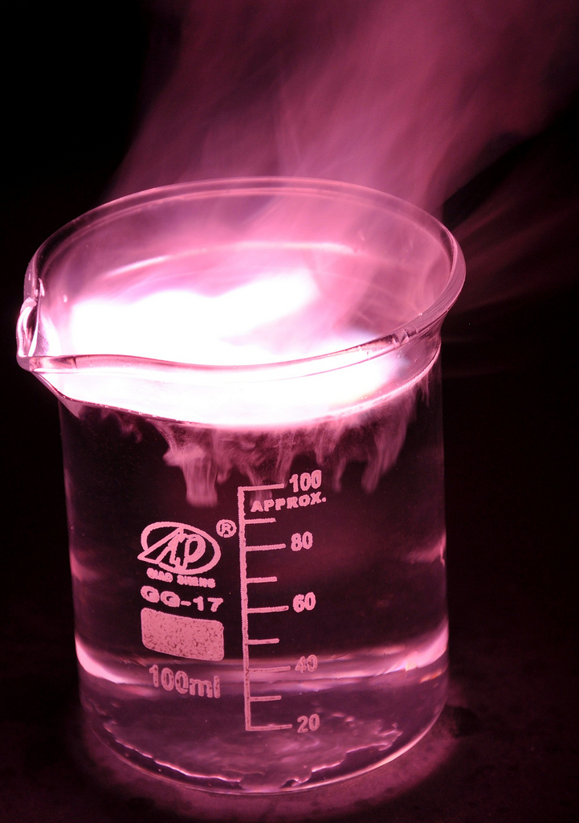
Overview Chemical changes
Reactions of acids
Acids and alkalis
Indicators
Strong and weak acids (HT)
Reactions with metals
pH and neutralisation
Salts
Titration
Tests for hydrogen and carbon dioxide
Electrolytic processes
Electrolysis of molten ionic compounds
Electrolysis of an aqueous solution
Purification of copper
Representation at electrodes as half equations (HT)
Notes:
https://c2.staticflickr.com/4/3178/4076380768_03994aed44_b.jpg

Slide 3

LearnIT!
KnowIT!
Reactions of acids
PART 1
Acids and alkalis
Indicators
Strong and weak acids (HT)
Reactions with metals

Slide 4
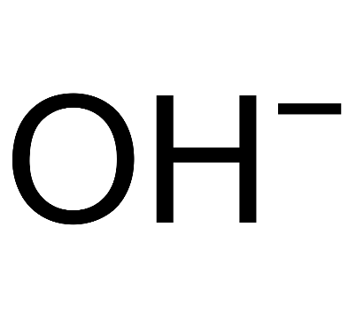
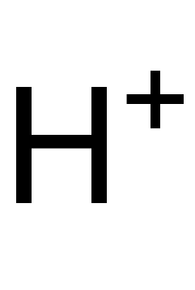
Reactions of acids - PART 1
Acids
Acids in solution are sources of hydrogen ions.
Acidic solutions have lower pH values than neutral pH 7.
Bases
A base is any substance that reacts with an acid to form a salt and water only.
Alkalis are soluble bases.
Alkalis in solution are sources of hydroxide ions.
Alkaline solutions have higher pH values than neutral 7.
HIGHER TIER only:
Higher H⁺ concentration = lower pH
Higher OH⁻ concentration = higher pH
Notes:
https://www.google.co.uk/url?sa=i&rct=j&q=&esrc=s&source=images&cd=&cad=rja&uact=8&ved=0ahUKEwi728qEqtHVAhWBWBQKHRPTD38QjRwIBw&url=https%3A%2F%2Fdc.edu.au%2Fhsc-chemistry-acidic-environment%2F&psig=AFQjCNG5fBPM30-007AJ_qlijTuBxZFN2g&ust=1502614668234720

Slide 5
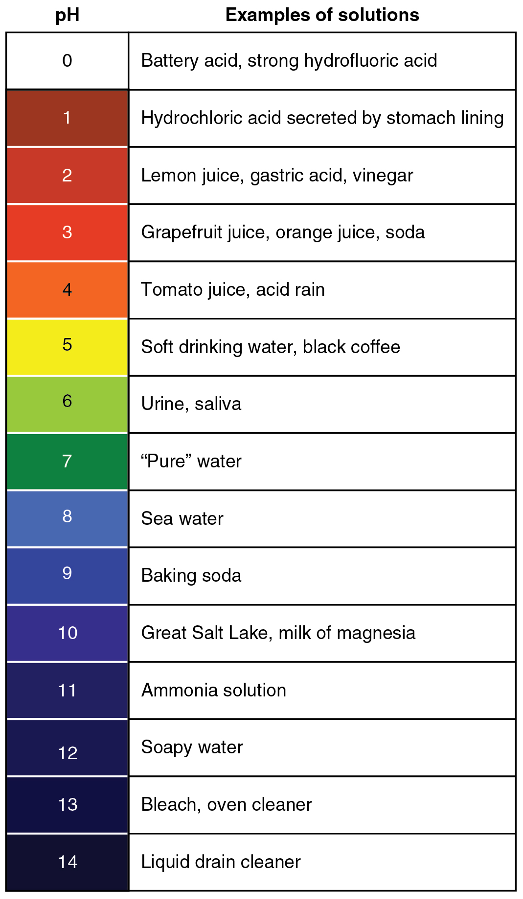
Reactions of acids - PART 1
Indicators are substances which change colour when you add them to acids and alkali.
Litmus goes red in acid and blue in alkali.
Methyl orange is red in acidic conditions, yellow in neutral and alkaline conditions.
Phenolphthalein is colourless in acidic and neutral conditions and pink in alkaline conditions.
Universal indicator, made from many dyes, is used to tell you pH. The scale runs from 0 (most acidic) to 14 (most alkaline). Aqueous solutions of acids have a pH value less than 7, and for alkalis greater than 7 and anything in the middle is neutral (pH 7). You can use a pH meter to record the change of a pH over time.
Notes:
https://opentextbc.ca/anatomyandphysiology/wp-content/uploads/sites/142/2016/03/2713_pH_Scale-01.jpg

Slide 6
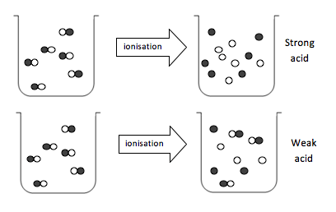
Reactions of acids – HIGHER - PART 1
The molecules split up to form hydrogen ions.
Acids must dissolve in water to show their acidic properties.
A concentrated acid has a relatively large amount of solute dissolved in the solvent. A dilute acid has a relatively smaller amount of solute dissolved in the solvent.
A strong acid is completely ionised in aqueous solution. Hydrochloric, nitric and sulfuric acid.
A weak acid is only partially ionised in aqueous solution. Ethanoic, citric and carbonic.
A weak acid (aq) has a lower pH than a strong acid (aq) of the same concentration.
This is because a weak acid has a lower concentration of hydrogen ions.
As the pH decrease by one unit, the hydrogen ion concentration of the solution increase by a factor of 10.
Concentration of hydrogen ions in mol/dm³ | pH
0.10 | 1.0
0.010 | 2.0
0.0010 | 3.0
0.00010 | 4.0
Notes:
https://www.google.co.uk/url?sa=i&rct=j&q=&esrc=s&source=images&cd=&cad=rja&uact=8&ved=0ahUKEwi728qEqtHVAhWBWBQKHRPTD38QjRwIBw&url=https%3A%2F%2Fdc.edu.au%2Fhsc-chemistry-acidic-environment%2F&psig=AFQjCNG5fBPM30-007AJ_qlijTuBxZFN2g&ust=1502614668234720

Slide 7
Reactions of acids - PART 1
Acids react with some metals to produce salts and hydrogen.
Metal + acid → salt + hydrogen
Reactions between metals and acids only occur if the metal is more reactive than the hydrogen in the acid. If the metal is too reactive, the reaction with acid is violent.
The salt that is made depends on the metal and acid used.
Salts made when metals react with nitric acid are called nitrates.
Zinc + Nitric acid → Zinc Nitrate + Hydrogen
Salts made when metals react with sulfuric acids are called sulfates.
Iron + Sulfuric Acid → Iron Sulfate + Hydrogen
Salts made when metals react with hydrochloric acid are called chlorides.
Magnesium + Hydrochloric acid → Magnesium Chloride + Hydrogen

Slide 8
Reactions of acids – HIGHER - PART 1
In the reaction between magnesium and hydrochloric acid, the hydrogen ions are displaced from the solution by magnesium as the magnesium is more reactive than hydrogen.
The following ionic equation occurs:
Mg(s) + 2H⁺(aq) → Mg²⁺(aq) + H₂(g)
The chloride ions are not included as they do not change in the reaction.
These are known as spectator ions.

Slide 9

QuestionIT!
Reactions of acids
PART 1
Acids and alkalis
Indicators
Strong and weak acids (HT)
Reactions with metals

Slide 10
Reactions of acids – QuestionIT
What type of ion are acids a source of?
What type of ion are alkalis a source of?
What pH do neutral, acids and alkaline solutions have?
Describe the colour changes of litmus in different pH solutions.
Describe the colour of methyl orange in different pH solutions.
Describe the colour of phenolphthalein in different pH solutions.

Slide 11
Reactions of acids – QuestionIT
Higher: What impact does increasing the H⁺ concentration in an acidic solution have upon the pH?
Higher: What impact does increasing the OH⁻ concentration have upon the pH?
Higher: As the pH increases by 1, what happens to the H⁺ concentration of the solution?
Higher: What does the term ‘dilute’ mean?
Higher: What does the term ‘concentrated’ mean?

Slide 12
Reactions of acids – QuestionIT
Higher: What does the term ‘weak acid’ mean?
Higher: What does the term ‘strong acid’ mean?
Write a balanced symbol equation, with state symbols, for the reaction between zinc and hydrochloric acid.
Higher: Write an ionic equation, with state symbols, to show magnesium reacting with hydrochloric acid.

Slide 13

AnswerIT!
Reactions of acids
PART 1
Acids and alkalis
Indicators
Strong and weak acids (HT)
Reactions with metals

Slide 14
Reactions of acids – QuestionIT
What type of ion are acids a source of?
Hydrogen ions/ H⁺
What type of ion are alkalis a source of?
Hydroxide ions/ OH⁻
What pH do neutral, acids and alkaline solutions have?
Neutral = 7; acids < 7; alkalis > 7
Describe the colour changes of litmus in different pH solutions.
Red in acids; blue in alkali.
Describe the colour of methyl orange in different pH solutions.
Red in acids; yellow in neutral and alkali.
Describe the colour of phenolphthalein in different pH solutions.
Colourless in acid and neutral; pink in alkali.

Slide 15
Reactions of acids – QuestionIT
Higher: What impact does increasing the H⁺ concentration in an acidic solution have upon the pH?
Lowers it.
Higher: What impact does increasing the OH⁻ concentration have upon the pH?
Increases it.
Higher: As the pH increases by 1, what happens to the H⁺ concentration of the solution?
Increases by a factor of 10.
Higher: What does the term ‘dilute’ mean?
Low/ less solute dissolved in a particular volume.
Higher: What does the term ‘concentrated’ mean?
High/ more solute dissolved in a particular volume.

Slide 16
Reactions of acids – QuestionIT
Higher: What does the term ‘weak acid’ mean?
Partially ionised in solution.
Higher: What does the term ‘strong acid’ mean?
Fully ionised in solution.
Write a balanced symbol equation, with state symbols, for the reaction between zinc and hydrochloric acid.
Zn_{(s)} + 2HCl_{(aq)} → ZnCl_{2(aq)} + H_{2(g)}
Higher: Write an ionic equation, with state symbols, to show magnesium reacting with hydrochloric acid.
Mg(s) + 2H⁺(aq) → Mg²⁺(aq) + H₂(g)

Slide 17
LearnIT!
KnowIT!
Reactions of acids
PART 2
Neutralisation
Salts
Titration

Slide 18
Reactions of acids - PART 2
Acids are neutralised by alkalis (e.g.: soluble metal hydroxides) and bases (e.g.: insoluble metal hydroxides and metal oxides) to produce salts and water and by metal carbonates to produce
salts, water and carbon dioxide.
The salt name depends on the acid used and the positive ions in the alkali, base or carbonate.
H⁺ and OH⁻ ions combine to form H₂O
Making Soluble Salts from acids and alkalis
Salts can be made by reacting an acid with an alkali.
Acid + Alkali → Salt + Water
Making Soluble Salts from acids and bases
Salts can be made by reacting an acid with a insoluble base.
Acid + Bases → Salt + Water
Making Soluble Salts from acids and metal carbonates
Salts can be made by reacting an acid with a metal carbonate.
Acid + Metal carbonate → Salt + Water + Carbon dioxide

Slide 19
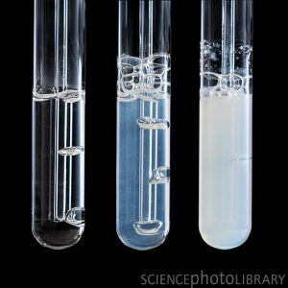
Reactions of acids - PART 2
Test For Hydrogen
The test for hydrogen uses a burning splint held at the open end of a test tube of the gas. Hydrogen burns rapidly with a pop sound.
Test For Carbon Dioxide
The test for carbon dioxide uses an aqueous solution of calcium hydroxide (lime water). When carbon dioxide is shaken or bubbled through limewater the limewater turns milky (cloudy).
You must learn these tests, including how the gas is tested and the positive result that proves that the chemical is the gas you are testing for.

Slide 20
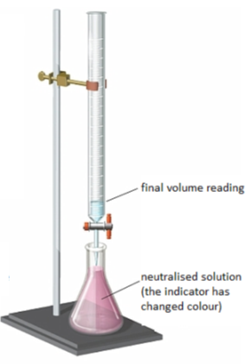
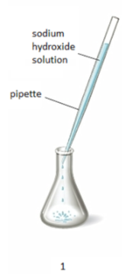
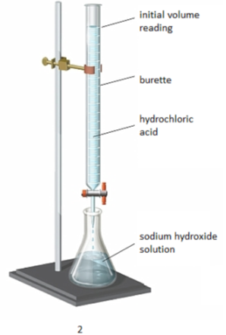
Reactions of acids - PART 2
The volumes of acid and alkali solutions that react with each other
can be measured by titration, using a suitable indictor.
3. Stop adding the acid when the end-point is reached (the appropriate colour change in the indicator happens). Note the final volume reading. Repeat steps 1 to 3 until you get consistent readings.
Use the pipette to add 25 cm³ of alkali to a conical flask and add a few drops of indicator.
2. Fill the burette with acid and note the starting volume. Slowly add the acid from the burette to the alkali in the conical flask, swirling to mix.
Notes:
https://www.google.co.uk/url?sa=i&rct=j&q=&esrc=s&source=images&cd=&cad=rja&uact=8&ved=0ahUKEwirr9O3pNHVAhUHvRQKHZ_IAe0QjRwIBw&url=https%3A%2F%2Ftaytaynm.wordpress.com%2F2014%2F05%2F01%2Fwho-cares-about-titration%2F&psig=AFQjCNHoK3AhdASNaybmu_T9HzIcQoxVjg&ust=1502612966877529

Slide 21
Reactions of acids - PART 2
You must learn these rules and be able to predict whether a precipitate will be formed, and be able to name it.
All common sodium, potassium and ammonium salts are soluble
All nitrates are soluble
Common chlorides are soluble except silver chloride and lead chloride
Common sulfates are soluble except those of lead, barium and calcium
Common carbonates and hydroxides are insoluble except those of sodium, potassium and ammonium.
Soluble
All nitrates
Common sodium, potassium and ammonium salts INCLUDING CARBONATES
Most chlorides and sulfates
Insoluble
Silver chloride and lead chloride
Lead sulfate, barium sulfate and calcium sulfate
Most carbonates

Slide 22

Reactions of acids - PART 2
Soluble salts can be made from acids by reacting them with solid insoluble substances, such as metals, metal oxides, hydroxides or carbonates.
Measure the required volume of acid with a measuring cylinder and add the weighed solid (insoluble metal, oxide, hydroxide or carbonate) in small portions with stirring.
Safety goggles required - the mixture may be heated to speed up the reaction. When no more of the solid dissolves, it means ALL the acid is neutralised and there should be a little excess solid.
Filter the solution to remove the excess solid metal/oxide/carbonate into an evaporating dish. On filtration, only a solution of the salt is left.
Then hot concentrated solution is left to cool and crystallise.
After crystallisation, you collect and dry the crystals with a filter paper. If the solution is heated, the solvent will evaporate faster. Heating a solution until all the solvent has evaporated is known as heating to dryness.
Notes:
https://www.google.co.uk/url?sa=i&rct=j&q=&esrc=s&source=images&cd=&cad=rja&uact=8&ved=0ahUKEwjl6OrzgdHVAhXKOxQKHVXZCWMQjRwIBw&url=http%3A%2F%2Fwww.docbrown.info%2Fpage03%2FAcidsBasesSalts06b.htm&psig=AFQjCNEGXguuSJFjPV4Fhv0gS1lj7C5dJw&ust=1502603833131650

Slide 23
Reactions of acids - PART 2
Insoluble salts can be made from two soluble salts.
Mix together solutions of soluble salts.
Insoluble salt will form a precipitate in the solution.
Filter off the precipitate and wash several times with pure water.
Dry precipitate in an oven.
Notes:
https://www.google.co.uk/url?sa=i&rct=j&q=&esrc=s&source=images&cd=&cad=rja&uact=8&ved=0ahUKEwjl6OrzgdHVAhXKOxQKHVXZCWMQjRwIBw&url=http%3A%2F%2Fwww.docbrown.info%2Fpage03%2FAcidsBasesSalts06b.htm&psig=AFQjCNEGXguuSJFjPV4Fhv0gS1lj7C5dJw&ust=1502603833131650

Slide 24
QuestionIT!
Reactions of acids
PART 2
Neutralisation
Salts
Titration

Slide 25
Reactions of acids – QuestionIT
What is the definition of an alkali?
What is a base?
What is the general equation for a reaction between acids and metal oxides?
What is the general equation for a reaction between acids and metal hydroxides?
What is the general equation for a reaction between acids and metal carbonates?

Slide 26
Reactions of acids – QuestionIT
Describe the test for hydrogen.
Describe the test for carbon dioxide.
What is a neutralisation reaction?
Describe how to carry out a titration.
Are nitrates soluble?
What can be said about common sodium, potassium and ammonium salts?

Slide 27
Reactions of acids – QuestionIT
Which chlorides are not soluble?
Which sulfates are not soluble?
Which carbonates are soluble?
Describe how to prepare a pure dry sample of an insoluble salt.

Slide 28
AnswerIT!
Reactions of acids
PART 2
Neutralisation
Salts
Titration

Slide 29
Reactions of acids – QuestionIT
What is the definition of an alkali?
Soluble base.
What is a base?
Any substance that reacts with an acid to form a salt and water only.
What is the general equation for a reaction between acids and metal oxides?
Acid + metal oxide → salt + water
What is the general equation for a reaction between acids and metal hydroxides?
Acid + metal hydroxide → salt + water
What is the general equation for a reaction between acids and metal carbonates?
Acid + metal carbonate → salt + water + carbon dioxide

Slide 30
Reactions of acids – QuestionIT
Describe the test for hydrogen.
Naked flame/ lighted splint; squeaky pop
Describe the test for carbon dioxide.
Limewater; milky/white
What is a neutralisation reaction?
Reaction between an acid and a base.
Describe how to carry out a titration.
Known volume of alkali into conical flask
Add indicator e.g. phenolphthalein
Fill burette with acid
Add acid to alkali until indicator shows neutral solution
Repeat
Are nitrates soluble?
Yes.

Slide 31
Reactions of acids – QuestionIT
What can be said about common sodium, potassium and ammonium salts?
Soluble.
Which chlorides are not soluble?
Silver chloride, lead chloride.
Which sulfates are not soluble?
Lead sulfate, barium sulfate, calcium sulfate.
Which carbonates are soluble?
Sodium carbonate, ammonium carbonate, potassium carbonate.
Describe how to prepare a pure dry sample of an insoluble salt.
Mix together solutions of soluble salts.
Insoluble salt will form a precipitate in the solution.
Filter off the precipitate
Wash several times with pure water.
Dry precipitate in an oven.

Slide 32
LearnIT!
KnowIT!
Electrolytic processes
PART 1
Electrolysis of a molten ionic compound
Electrolysis of an aqueous solution

Slide 33
Electrolysis - PART 1
When an ionic compound is melted or dissolved in water, the ions are free to move about the liquid or solution. These liquids and solutions are able to conduct electricity and are called electrolytes. Passing an electric current though electrolytes causes the ions to move to the electrodes.
Direct current (DC) supply
Cations (positive ions) go to negative electrode (cathode).
Anions (negative ions go) to the positive electrode (anode).
Ions are discharged at the electrodes producing elements. This is called electrolysis.
_
+
Negative electrode (cathode)
Positive electrode (anode)
+
-
-
+
+
-
HIGHER:
Cations are REDUCED, they gain electrons at the cathode.
Anions are OXIDISED, they lose electrons at the anode.
+
-
+
-

Slide 34
Electrolysis - PART 1
When an ionic compound is electrolysed in a molten state using inert electrodes, the metal is produced at the cathode and the non metal is produced at the anode.
lead bromide → lead + bromine
_
+
Higher: You can represent what is happening at each electrode using half equations.
+
-
Bromide ions Br ⁻
Lead ions Pb ⁺
+
-
+
-
+
-
Molten lead (II) bromide
+
-
The positively charged lead ions Pb + (cations) are attracted to the cathode and the negatively charged bromide ions Br ⁻ are attracted to the anode.
Higher:
At the cathode
Pb ²⁺ + 2e – → Pb
Higher:
At the anode
2Br ⁻ → Br₂ + 2e – or 2Br ⁻ - 2e ⁻ → Br₂
Notes:
https://bam.files.bbci.co.uk/bam/live/content/zcwngk7/large

Slide 35
Electrolysis - PART 1
The ions discharged when an aqueous solution is electrolysed using inert electrodes depend on the relative reactivity of the elements involved.
At the negative electrode:
Metal will be produced on the electrode if it is less reactive than hydrogen.
Hydrogen will be produced if the metal is more reactive than hydrogen.
At the positive electrode:
Oxygen is formed at positive electrode.
If you have a halide ion (Cl⁻, I⁻, Br⁻) then you will get chlorine, bromine or iodine formed at that electrode.
This happens because in the aqueous solution, water molecules break down producing hydrogen ions and hydroxide ions that are discharged.
H₂O(l) → H⁺(aq) + OH⁻(aq)
Higher: At the anode
4OH⁻ → O₂ + 2H₂O + 4e⁻
or 4OH⁻ – 4e⁻ → O₂ + 2H₂O
_
+
Chloride Cl ⁻
Hydrogen H⁺
+
+
-
-
Sodium chloride solution
+
-
-
+
+
-
sodium chloride → hydrogen + chlorine
+ sodium hydroxide
Uses of the products:
Chlorine: Bleach and PVC
Hydrogen: Margarine Sodium hydroxide: Bleach and soap
Higher:
At the cathode
2H⁺ + 2e – → H₂
Higher:
At the anode
2Cl ⁻ → Cl₂ + 2e – or 2Cl ⁻ - 2e ⁻ → Cl₂
Notes:
https://bam.files.bbci.co.uk/bam/live/content/zbktvcw/large

Slide 36
Electrolysis - PART 1
Copper chloride | Sodium sulfate | Acidified (H₂SO₄) water
Forms Cu and Cl₂ Higher: At the cathode Cu ²⁺ + 2e – → Cu At the anode 2Cl ⁻ - 2e ⁻ → Cl₂ | Forms H₂ and O₂ Higher: At the cathode 2H⁺ + 2e – → H₂ At the anode 2O²⁻ → O₂ + 4e – | Forms H₂ and O₂ Higher: At the cathode 2H⁺ + 2e – → H₂ At the anode 2O²⁻ → O₂ + 4e –
Notes:
https://bam.files.bbci.co.uk/bam/live/content/zcwngk7/large

Slide 37
QuestionIT!
Electrolytic processes
PART 1
Electrolysis of a molten ionic compound
Electrolysis of an aqueous solution

Slide 38
Electrolysis – QuestionIT
Why can a molten or dissolved ionic compound conduct electricity?
What is electrolysis?
What is the name of the electrode that positive ions move to?
What is the name of the electrode that the negative ions move to?
What is produced at the cathode when lead bromide is electrolysed?
What is produced at the anode when lead bromide is electrolysed?

Slide 39
Electrolysis – QuestionIT
What is produced at the cathode if the metal in the solution is more reactive than hydrogen?
What is produced at the anode if the solution does not contain halide ions?
HT Only: Write half equations for the reactions that happen at the
electrodes during the electrolysis of molten copper chloride.
10. Predict the products of electrolysis of copper sulfate solution.
11. HT Only: Write a half equation for the reactions that happen at the
electrodes during the electrolysis of copper chloride solution.

Slide 40
AnswerIT!
Electrolytic processes
PART 1
Electrolysis of a molten ionic compound
Electrolysis of an aqueous solution

Slide 41
Electrolysis – QuestionIT
Why can a molten or dissolved ionic compound conduct electricity?
Free moving ions.
What is electrolysis?
When an electric current is passed through a molten or aqueous ionic solution and the salt breaks down into simpler substances.
What is the name of the electrode that positive ions move to?
Cathode.
What is the name of the electrode that the negative ions move to?
Anode.
What is produced at the cathode when lead bromide is electrolysed?
Lead.
What is produced at the anode when lead bromide is electrolysed?
Bromine.

Slide 42
Electrolysis – QuestionIT
What is produced at the cathode if the metal in the solution is more reactive than hydrogen?
Hydrogen.
What is produced at the anode if the solution does not contain halide ions?
Oxygen.
HT Only: Write half equations for the reactions that happen at the
electrodes during the electrolysis of molten copper chloride.
Negative electrode: Cu²⁺(aq) + 2e⁻ → Cu(s)
Positive electrode: 2Cl⁻(aq) → Cl₂(g) + 2e⁻
10. Predict the products of electrolysis of copper sulfate solution.
Positive electrode: Oxygen gas; Negative electrode: Copper.
11. HT Only: Write a half equation for the reactions that happen at the
electrodes during the electrolysis of copper chloride solution.
Negative electrode: Cu²⁺(aq) + 2e⁻ → Cu(s)
Positive electrode: 2Cl⁻(aq) → Cl₂(g) + 2e⁻

Slide 43
LearnIT!
KnowIT!
Electrolytic
processes
PART 2
Purification of copper sulfate

Slide 44
Electrolysis - PART 2
Purifying copper by electrolysis
Electrolysis of copper sulfate solution using copper electrode.
The anode is made from impure copper.
The cathode is made from pure copper.
Direct current (DC) supply
_
+
Cathode – pure copper
Increases in mass
Pure copper forms on the surface
Higher:
Cu ²⁺ + 2e – → Cu
Anode – impure copper
Decreases in mass
Copper ions form
Higher:
Cu → Cu ²⁺ + 2e –
+
-
-
+
+
-
+
-
+
-
Copper (II) sulfate solution
Notes:
https://bam.files.bbci.co.uk/bam/live/content/zcwngk7/large

Slide 45
QuestionIT!
Electrolytic processes
PART 2
Purification of copper sulfate

Slide 46
Electrolysis – QuestionIT
All the following questions relate to the purification of copper using electrolysis.
Define oxidation and reduction in terms of electrons.
What is meant by the term ‘cation’?
What are the electrodes made of?
Which electrode would increase in mass? Why?

Slide 47
Electrolysis – QuestionIT
All the following questions relate to the purification of copper using electrolysis.
What is the electrolyte solution used in the purification of copper?
What happens at the anode?
What is the ionic equation for the reaction taking place at the cathode?

Slide 48
AnswerIT!
Electrolytic processes
PART 2
Purification of copper sulfate

Slide 49
Electrolysis – QuestionIT
All the following questions relate to the purification of copper using electrolysis.
Define oxidation and reduction in terms of electrons.
OIL RIG; oxidation is loss of electrons, reduction is gain of electrons.
What is meant by the term ‘cation’?
Positive ion (normally a metal ion).
What are the electrodes made of?
Cathode = pure copper; anode = impure copper.
Which electrode would increase in mass? Why?
Cathode; pure copper is forming on the surface from copper cations in solution.

Slide 50
Electrolysis – QuestionIT
All the following questions relate to the purification of copper using electrolysis.
What is the electrolyte solution used in the purification of copper?
Copper sulfate solution.
What happens at the anode?
Decrease in mass; copper cations leave the anode.
What is the ionic equation for the reaction taking place at the cathode?
Cu²⁺ + 2e⁻ → Cu

